Slide 1

ASQ – Edwards Medal
Overview of ASQ Edwards Medal
Committee Chair – D. Zrymiak, ASQ Fellow
July 2017

Slide 2
Presentation Summary
1
About The ASQ Edwards Medal
Efficient Verification)
Efficient Verification)
2
George Edwards and Edwards Medalists
Efficient Verification)
Efficient Verification)
3
Categories For Consideration
Efficient Verification)
4
Eligible Objective Evidence
Efficient Verification)
Efficient Verification)
5
Screening and Selection Process
Efficient Verification)
Efficient Verification)
Workshop
Efficient Verification)
Efficient Verification)

Slide 3
1 – Who does The Edwards Medal recognize?
The ASQ Edwards Medal is presented to the individual who has demonstrated the most outstanding leadership in the application of modern quality control methods, especially through organizing and administering such work. https://asq.org/about-asq/asq-awards/edwards
This medal recognizes a top Quality functional leader in an organization or enterprise.

Slide 4
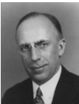
2 – What was George Edwards’ legacy?
One of the steps in the TC webinar process was that after a number of webinars had been run, that the content be reviewed by an objective reviewer to determine if the series continue, adjust, or stop. Dani had agreed to take that challenge, and came to the conclusion that the content, duration and presentation styles were too inconsistent and not meeting basic criteria for a Quality webinar. The effort will transition into the development of a proposal (advanced by Dani) to do short, concise adverts using a single voice (voice over slides) and a standard template to control content and time.
George DeForest Edwards, the first president of ASQ (1946-48), was the head of the inspection engineering department of Bell Telephone Laboratories and was Bell’s director of quality assurance, where he made many contributions.
https://asq.org/about-asq/honorary-members/edwards

Slide 5
2 – Who has the Edwards Medal recognized?
The recipients represent an elite tier of Quality figures who inspired their own ASQ Medals:
      1997 Spencer Hutchens Jr.
      1993 John D. Hromi
      1982 Thomas C. McDermott Jr.
      1981 Philip B. Crosby
      1972 E. Jack Lancaster
      1969 Dorian Shainin
      1965 Armand V. Feigenbaum
      1961 Joseph M. Juran
https://asq.org/about-asq/asq-awards/honors/edwards
One of the steps in the TC webinar process was that after a number of webinars had been run, that the content be reviewed by an objective reviewer to determine if the series continue, adjust, or stop. Dani had agreed to take that challenge, and came to the conclusion that the content, duration and presentation styles were too inconsistent and not meeting basic criteria for a Quality webinar. The effort will transition into the development of a proposal (advanced by Dani) to do short, concise adverts using a single voice (voice over slides) and a standard template to control content and time.

Slide 6
3 – Categories for Consideration
Candidates for the ASQ Edwards Medal are scored
based on their accomplishments within these Categories:
Technical Competence
Management Creativity and Development
Organizational Innovation in Product or Service Quality Control
Outstanding Managerial, executive leadership that is visible and demonstrable (nationally or internationally) in a service organization, industry, government, or ASQ
Leadership
Publications
Association Management
Contributions
Nomination packages require objective evidence and narratives,
along with the distinction of contributions by impact and time.

Slide 7
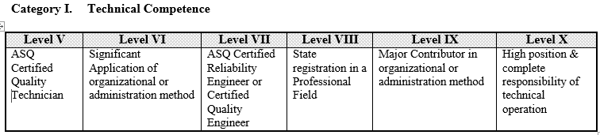
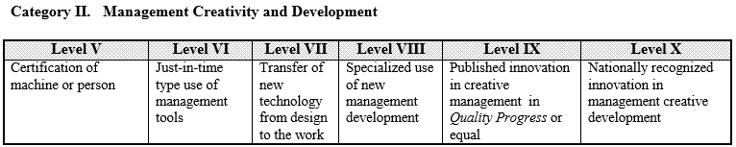
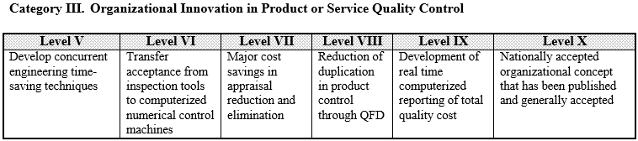
3 – Categories for Consideration
Examples of achievement levels are provided for comparative references

Slide 8
4 – Eligible Objective Evidence
All claims and assertions must be supported by verifiable objective evidence, accompanying the application.
Testimonials must include contact information to validate claims and elaborate on achievements and impacts.
Portions of the body of work referenced for prior ASQ Awards (i.e. books or articles already recognized with Crosby or Shewhart Medal; or Brumbaugh or Gryna Awards) cannot be recycled for Edwards Medal.
Achievements can be credited once in the award criteria

Slide 9
5 – Screening and Selection Process
Nomination Forms are due by Oct. 1.
Please send completed nomination to:
ASQ
Awards Administrator
600 N. Plankinton
Milwaukee, WI 53201
tbandy@asq.org
The ASQ Edwards Medal Committee will review all nomination forms received on time and accepted by your ASQ Awards Administrator for consideration.
Following objective reviews, verification of claims, and validation of testimonials, the consensus choice will be forwarded to the ASQ Awards Board for nomination.

Slide 10

ASQ Edwards Committee –
Actions For Fellows and Member Leaders
  Promote ASQ Medals and Recognitions
  Identify and elicit worthy candidates
  Compile and prepare nomination packages
  Send forms to ASQ Awards Administrator
  https://asq.org/about-asq/asq-awards/edwards
  ASQ Awards
  ASQ Edwards Medal Committee

Slide 11
Questions? https://asq.org/about-asq/asq-awards/edwards
Contact: Daniel Zrymiak dzss@shaw.ca; (604) 575-3269
Thank you for your consideration.

